Slide 1
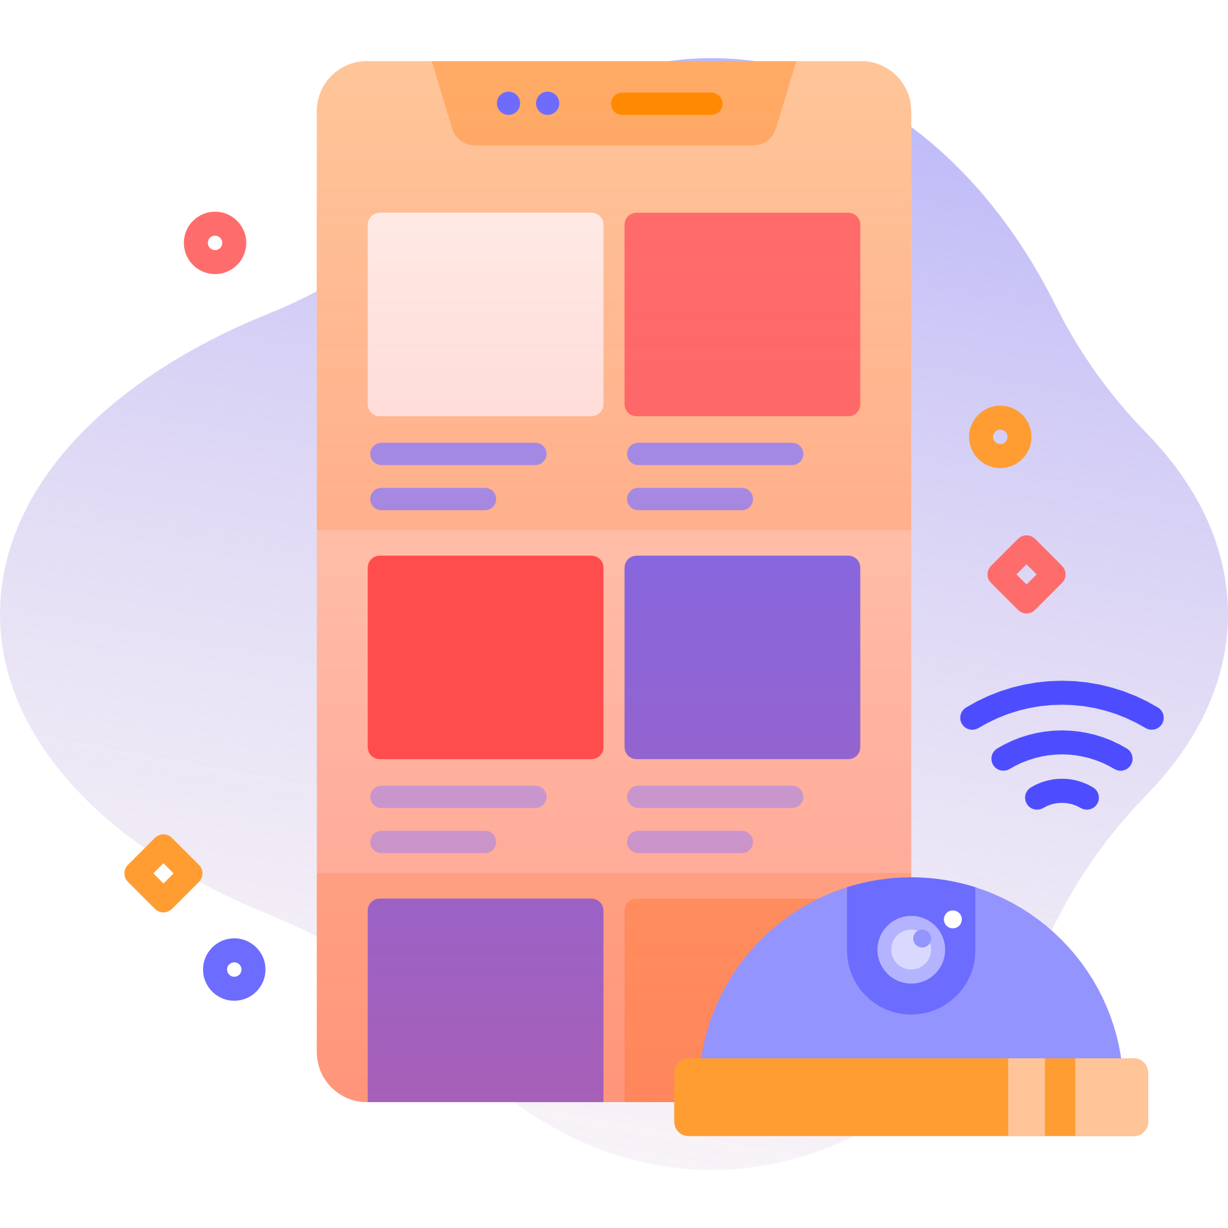
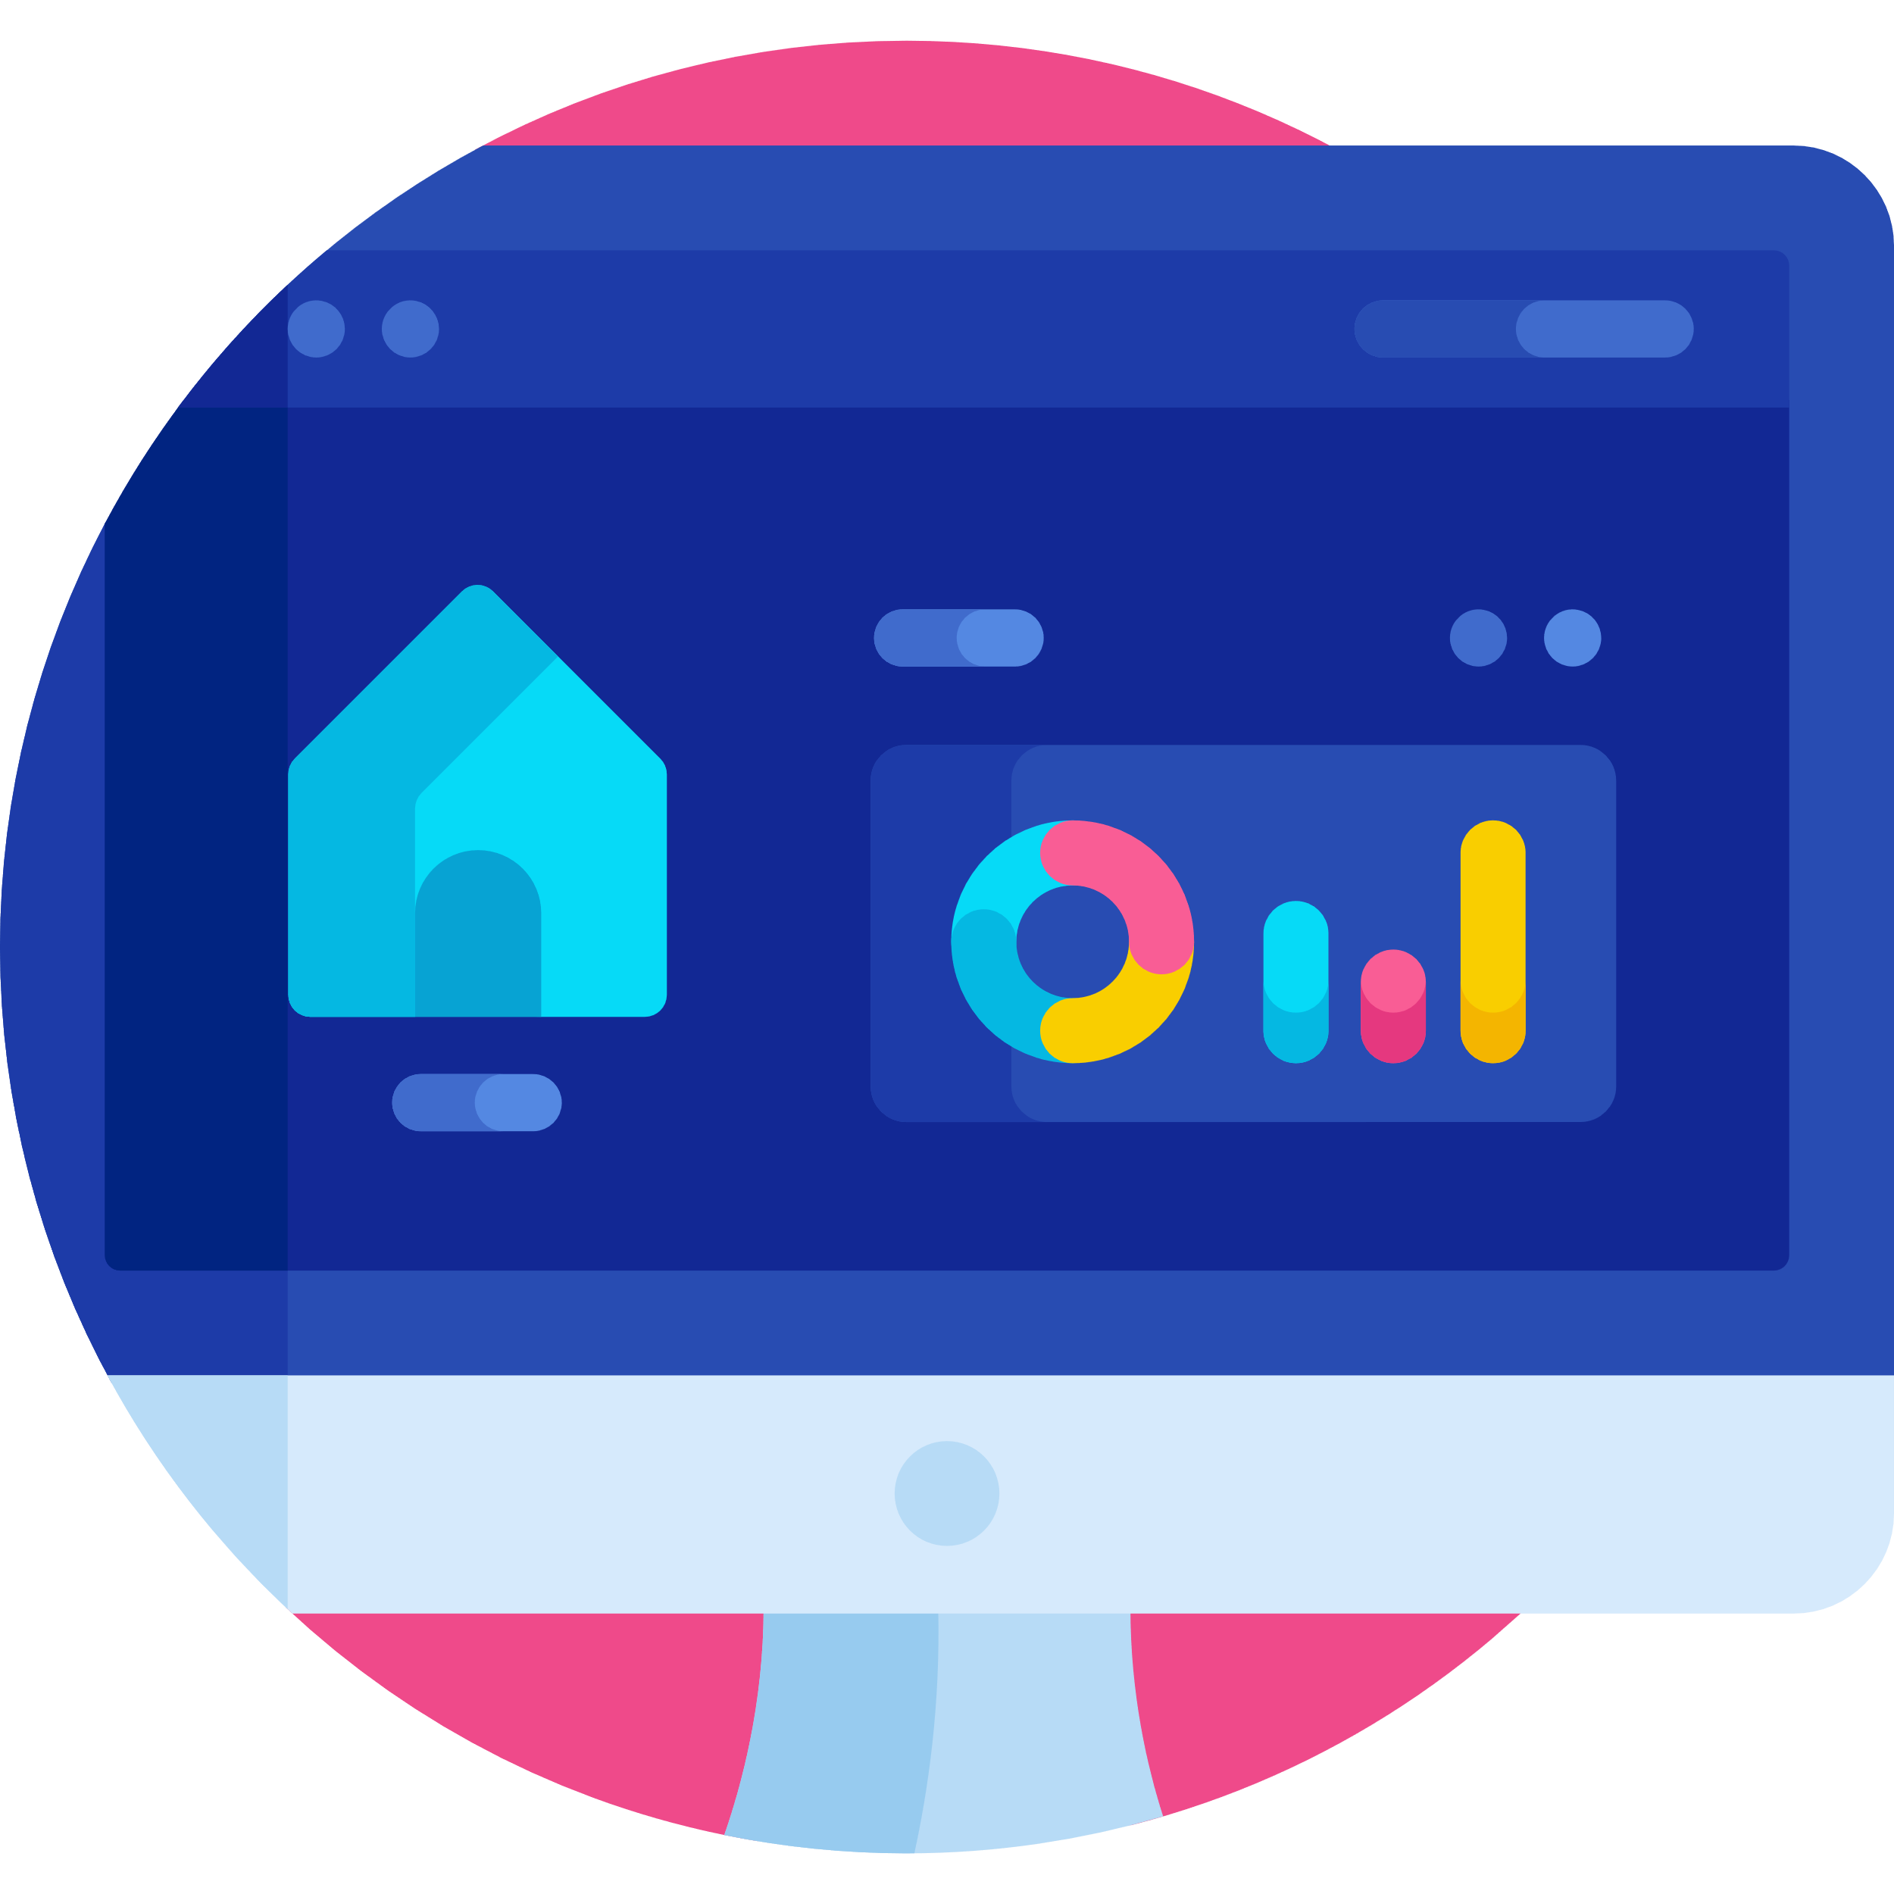
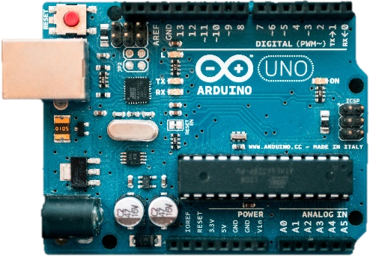
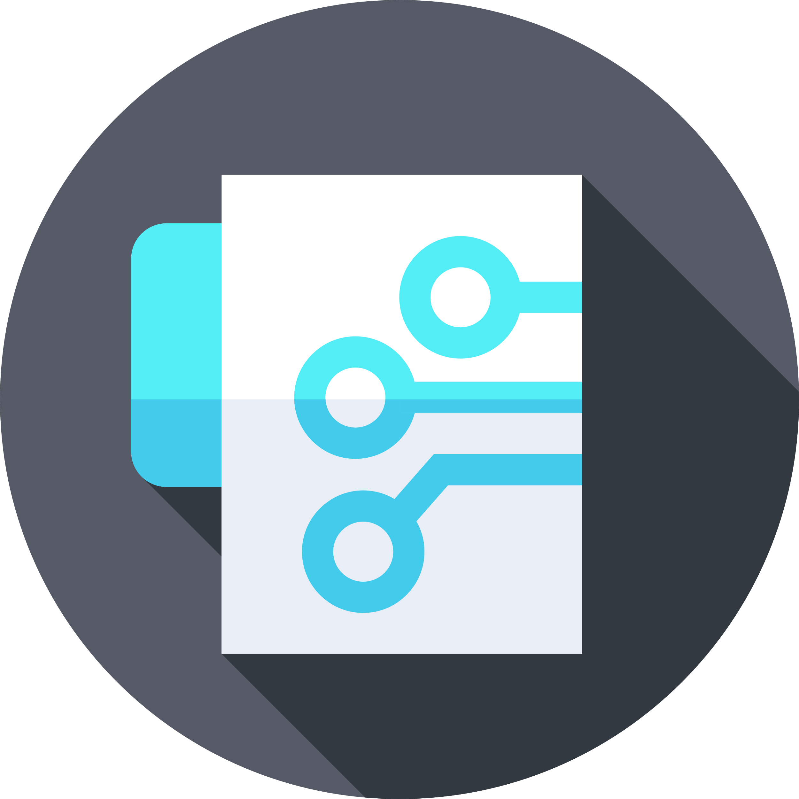
Internet
Internet
Of
Of
Things
Things
Instructor: Aman Singh

Slide 2
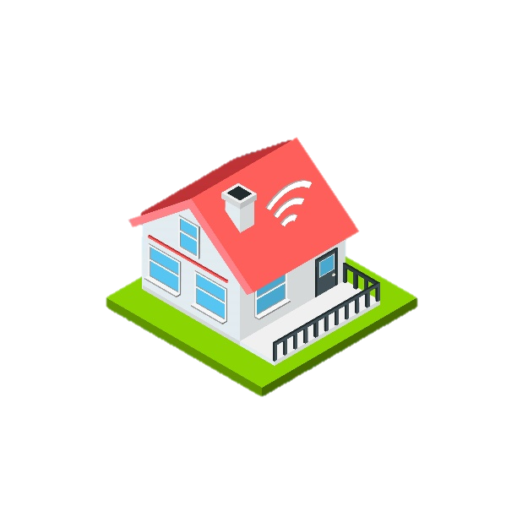
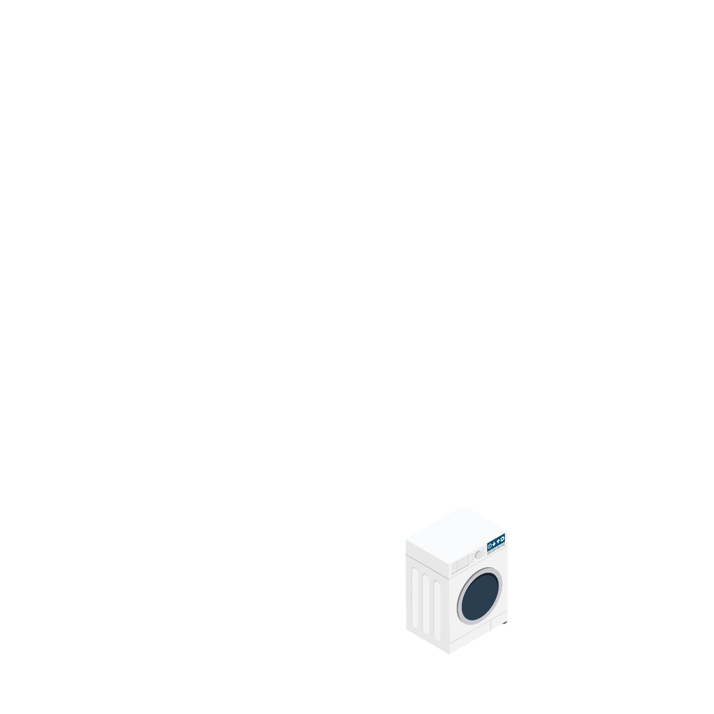
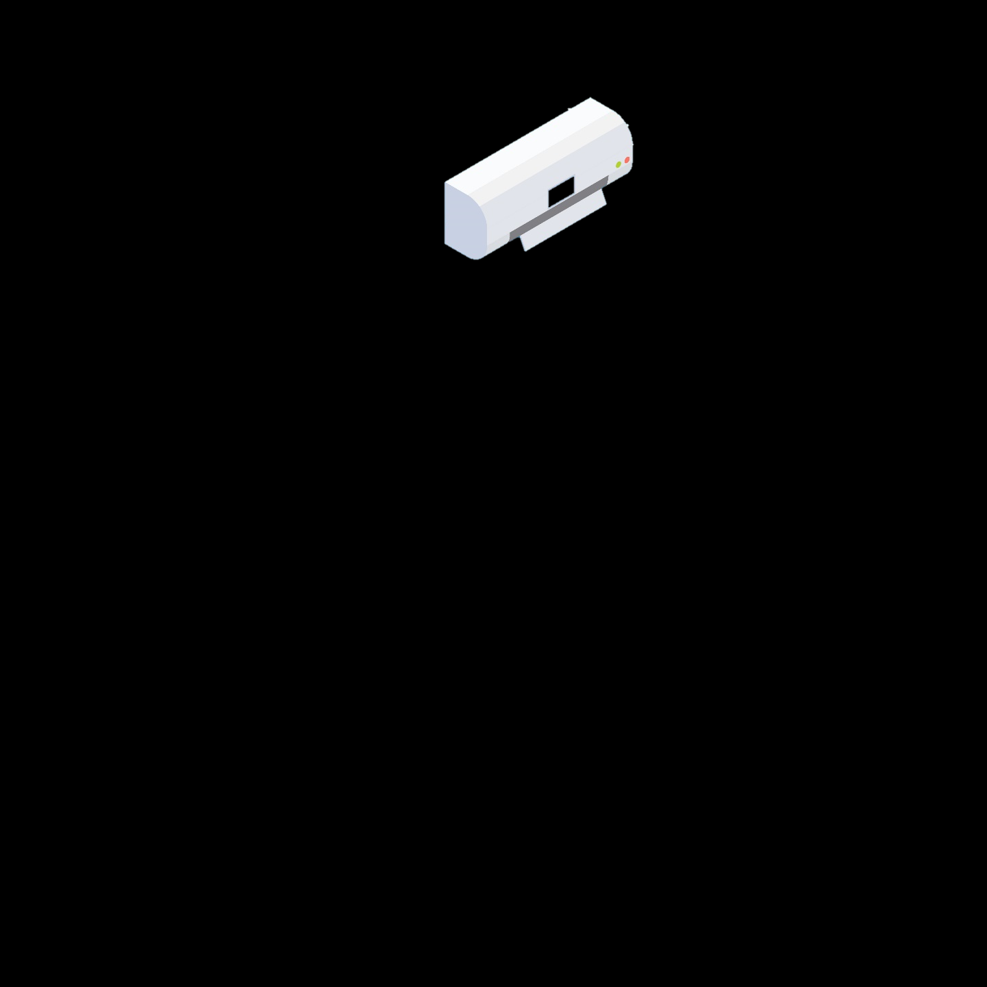
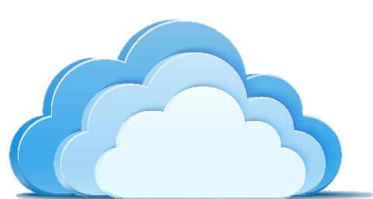
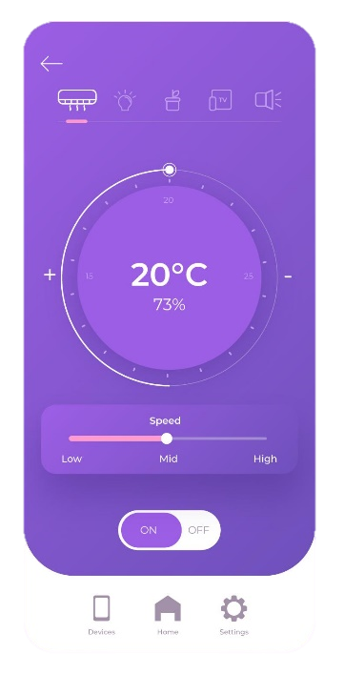

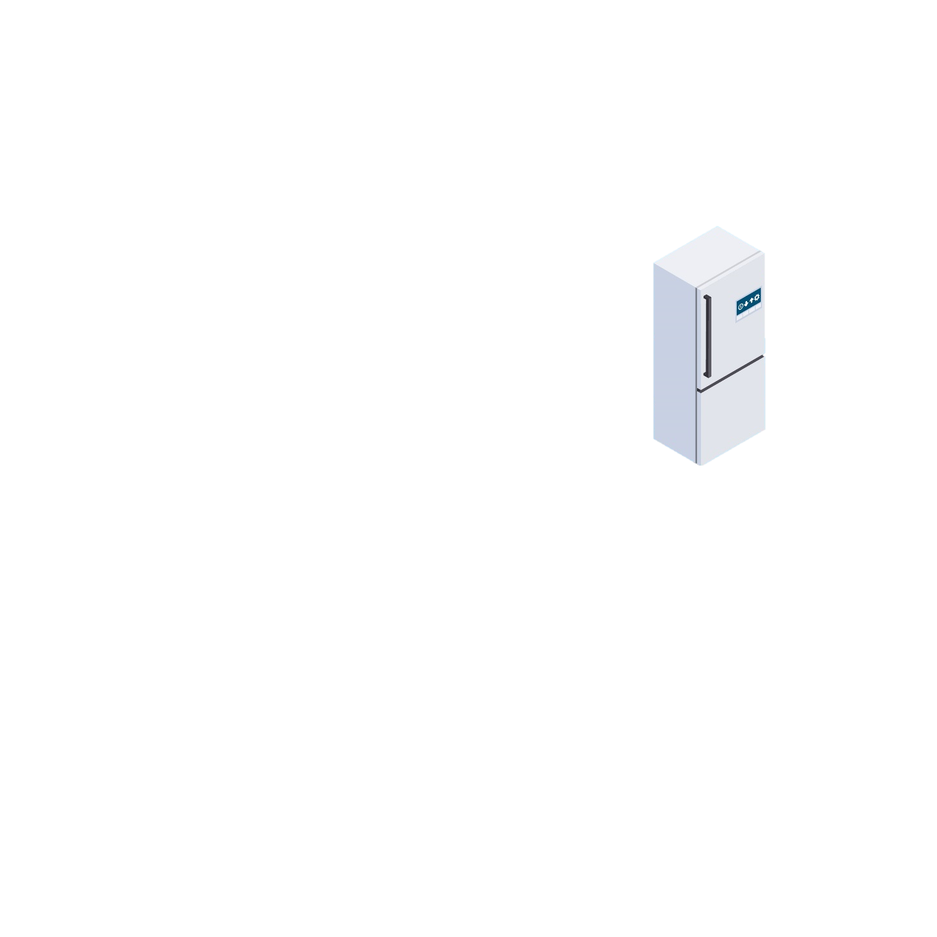
Internet of Things
According to Wikipedia:
The Internet of things (IoT) describes the network of physical objects—“things”—that are embedded with sensors, software, and other technologies for the purpose of connecting and exchanging data with other devices and systems over the Internet

Slide 3
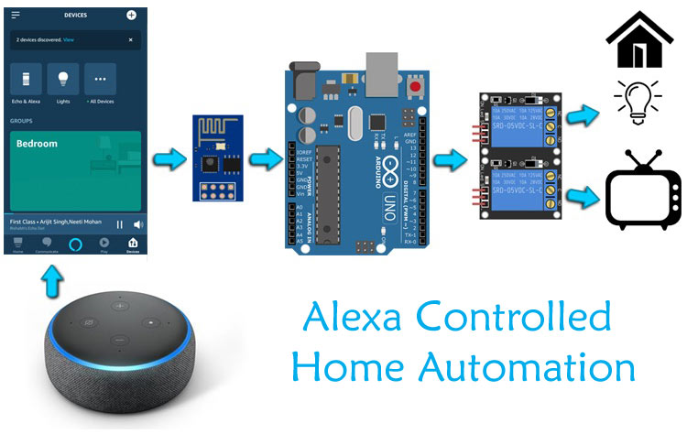
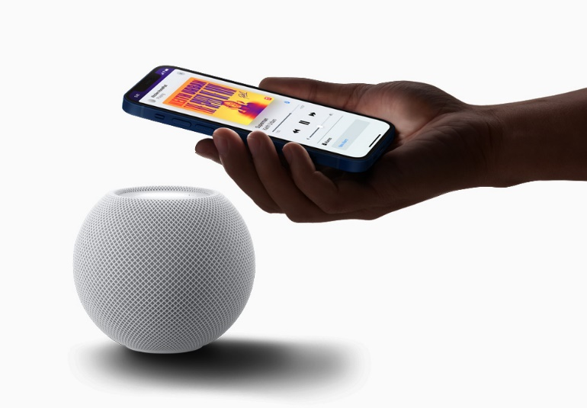
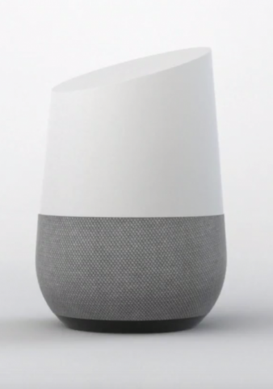


Current Trends and Devices

Slide 4
Application of IoT in Different Domains
Home Automation, Elder Care & Differently Abled, Medical, Transportation, Agriculture.

Slide 5
Home Automation
IoT devices are a part of the larger concept of home automation, which can include lighting, heating and air conditioning, media and security systems and camera systems.
Long-term benefits could include energy savings by automatically ensuring lights and electronics are turned off or by making the residents in the home aware of usage

Slide 6
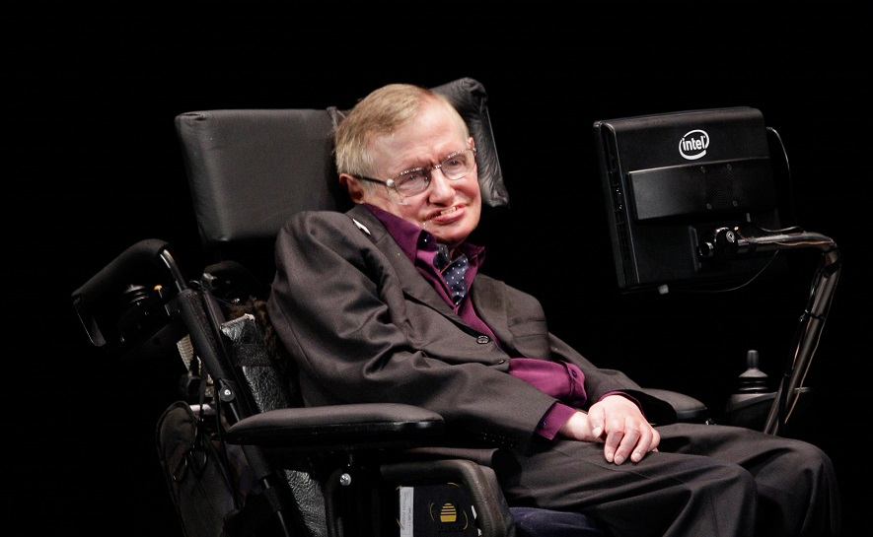
Differently Abled or Elder Care
One key application of a smart home is to provide assistance for those with disabilities and elderly individuals.
Voice control can assist users with sight and mobility limitations while alert systems can be connected directly to cochlear implants worn by hearing-impaired users.
They can also be equipped with additional safety features. These features can include sensors that monitor for medical emergencies such as falls or seizures.

Slide 7
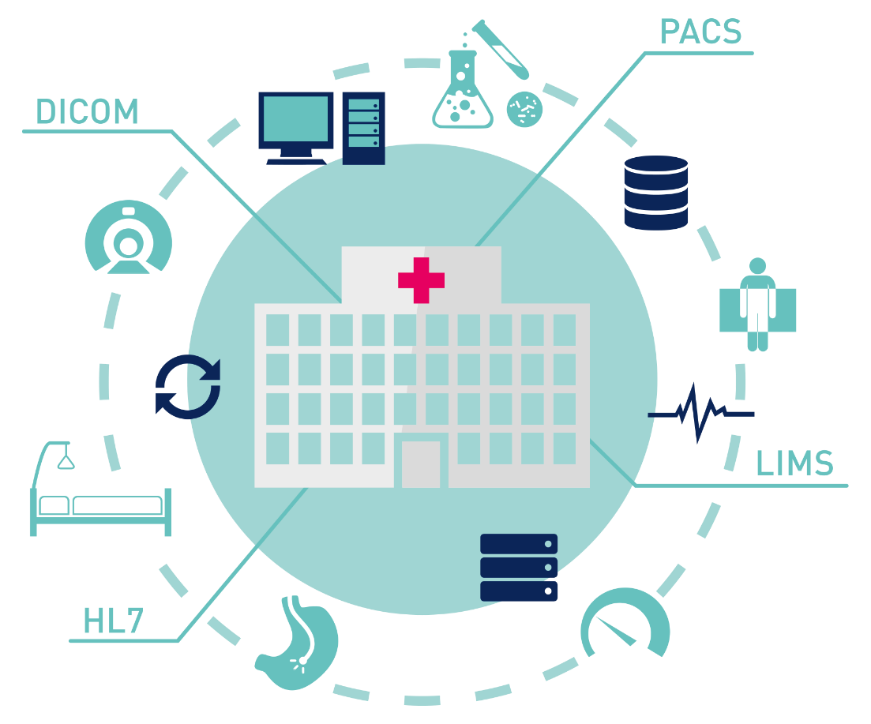
Medical and Healthcare
The Internet of Medical Things (IoMT) is an application of the IoT for medical and health related purposes, data collection and analysis for research, and monitoring.
The IoMT has been referenced as "Smart Healthcare", as the technology for creating a digitized healthcare system, connecting available medical resources and healthcare services.
The best example can be a smart watch, used to monitor patient’s health remotely. Thing like blood pressure and heart rate can be monitored.

Slide 8
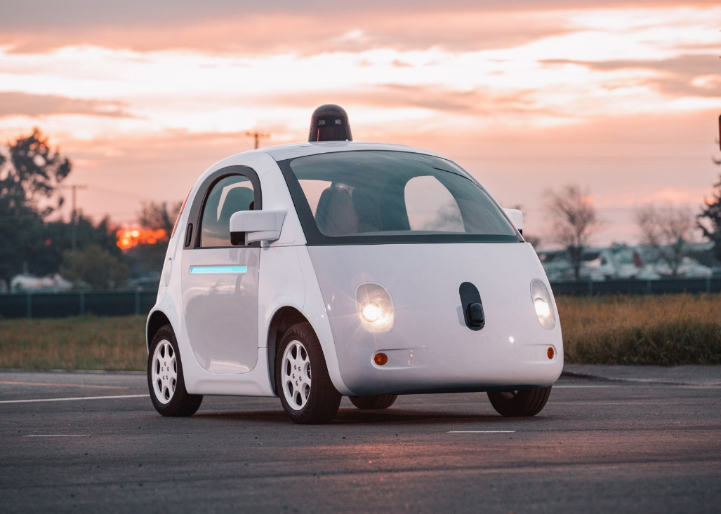
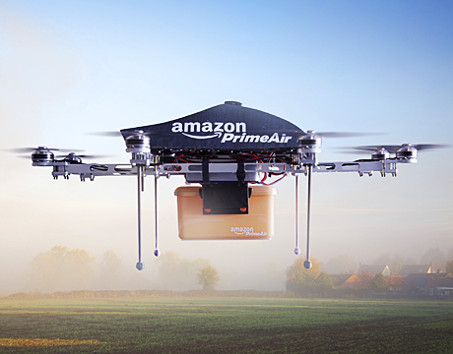
Transportation
The IoT can assist in the integration of communications, control, and information processing across various transportation systems.
Autonomous Cars are the Future.
These cars are AI driven and uses a lot of machine learning and IoT.
Companies like google, Tesla, and uber are already working on driverless cars.
Amazon took it one step further and started to make deliveries using Drones.

Slide 9
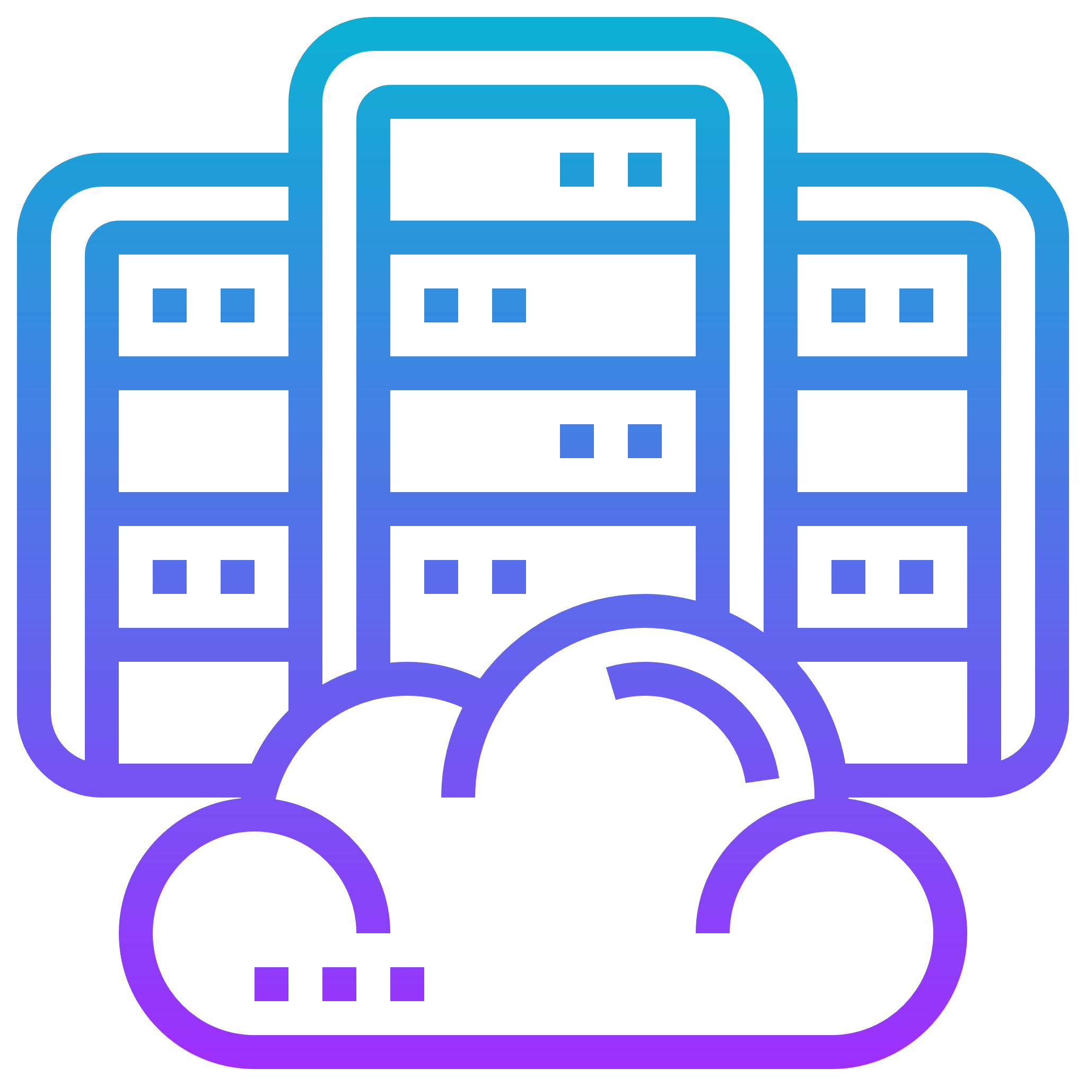
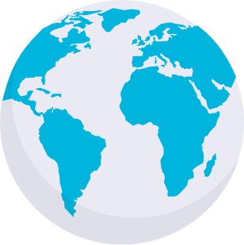
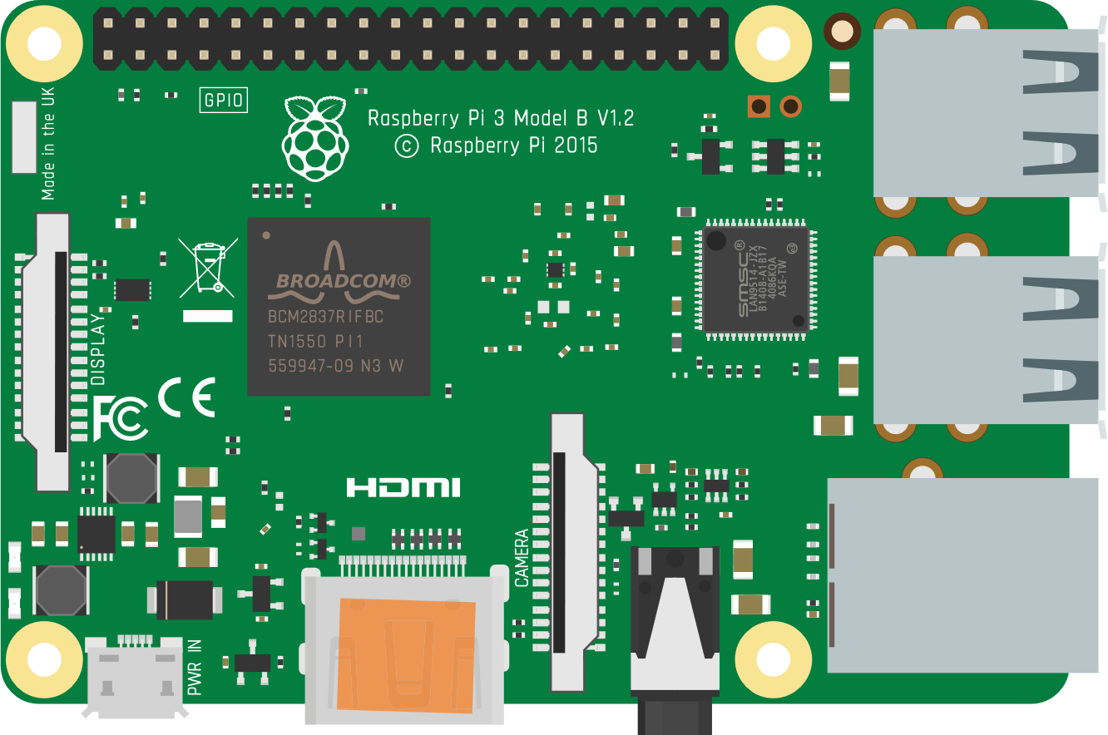
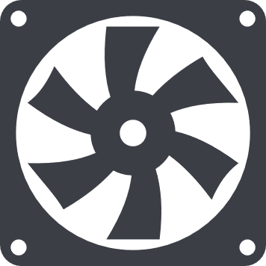
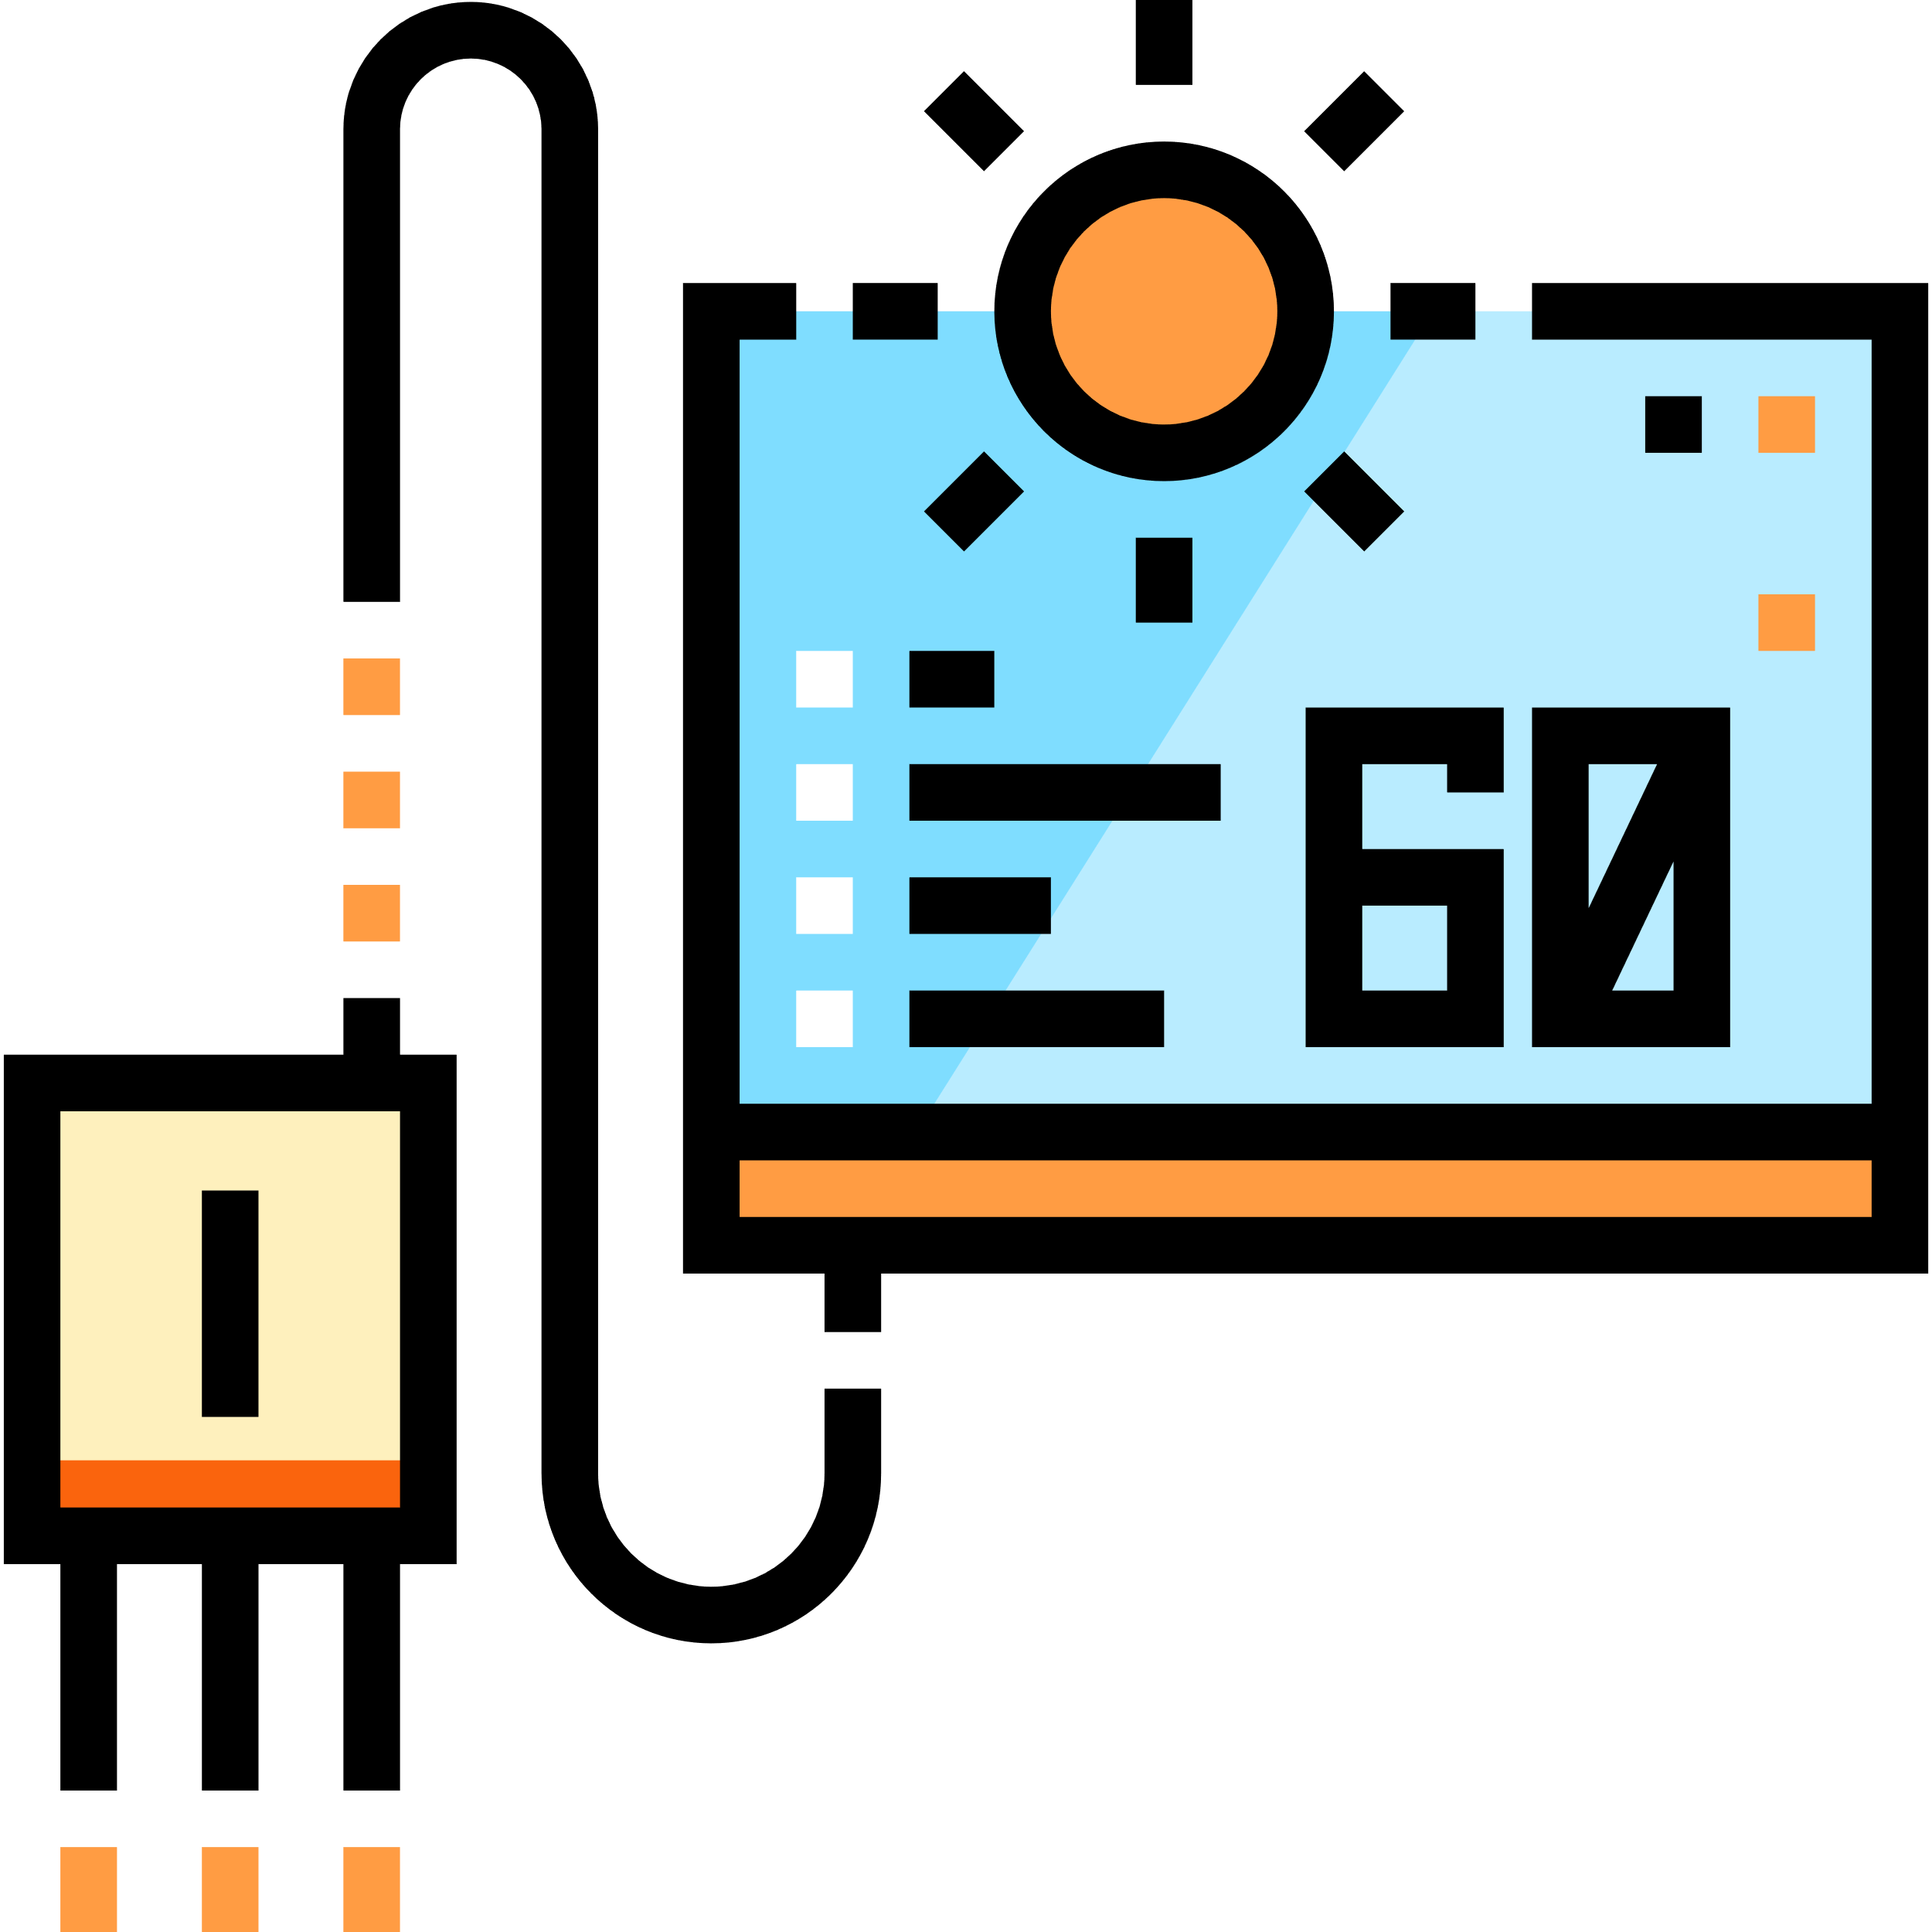
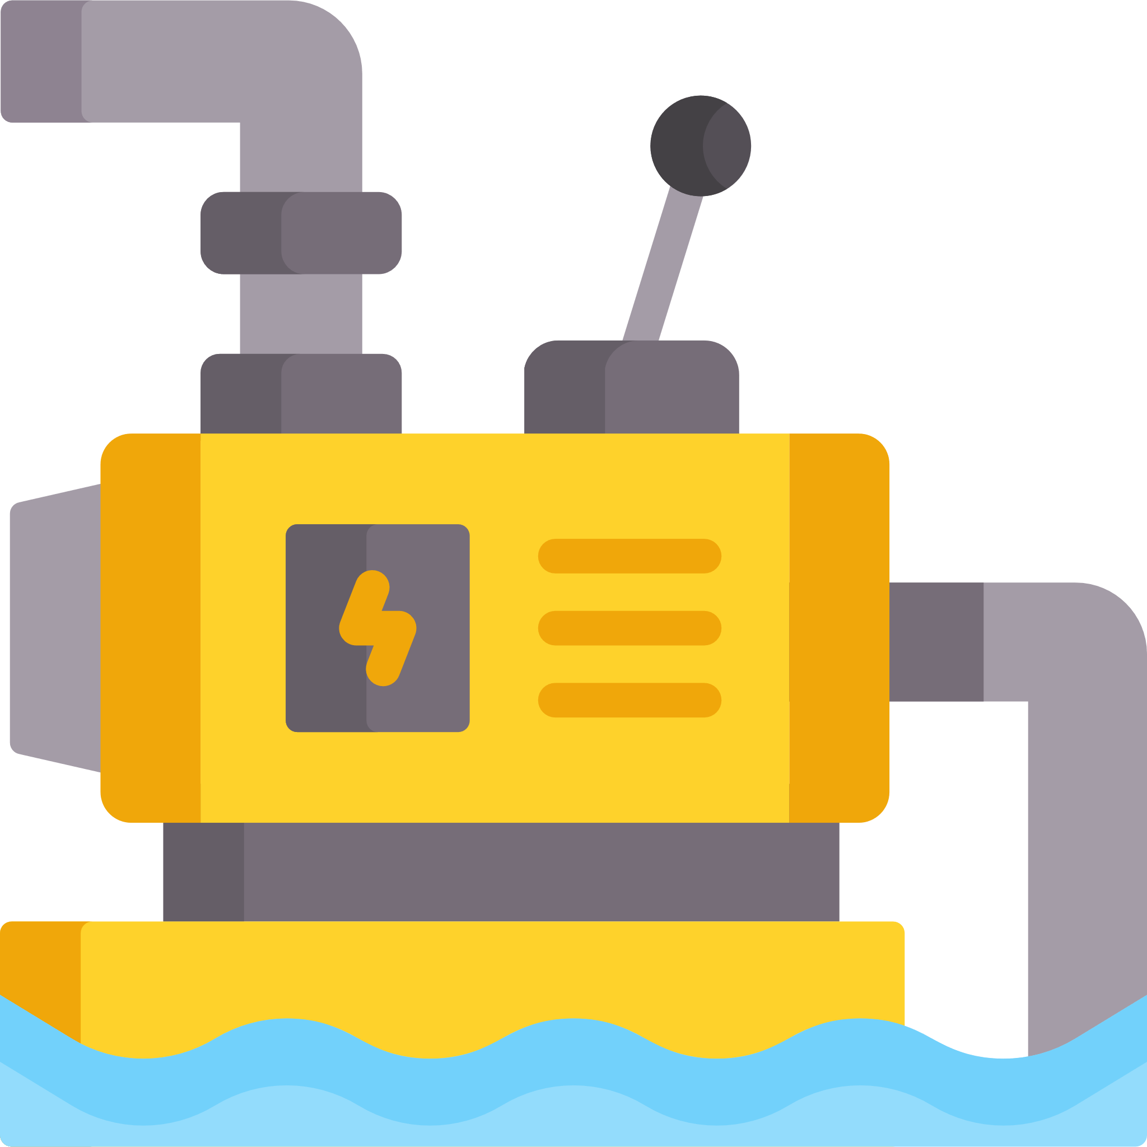

Agriculture
There are numerous IoT applications in farming such as collecting data on temperature, rainfall, humidity, wind speed, pest infestation, and soil content.
This data can be used to automate farming techniques, take informed decisions to improve quality and quantity, minimize risk and waste, and reduce effort required to manage crops.
For example, farmers can now monitor soil temperature and moisture from afar, and even apply IoT-acquired data to precision fertilization programs.
My Prototype Web APP www.github.com/Amansinghtech/Flask-IoT-Dashboard
REST
APIs
Amazon AWS Server
Internet
Central Node
Ventilation Fans
Wireless
Sensor
Modules
Water Pump
Sprinklers

Slide 10
Fundamental Components of an IoT project
The Brain (Microcontrollers like Arduino or Raspberry Pi)
Sensors (temp, humidity, gas, camera, color etc.)
Actuator/Motors (can be called as muscles of our project)
Connectivity (Wi-Fi, Bluetooth or RF)
Power (Wall Plug or Battery)
Cloud Computing and Programming

Slide 11
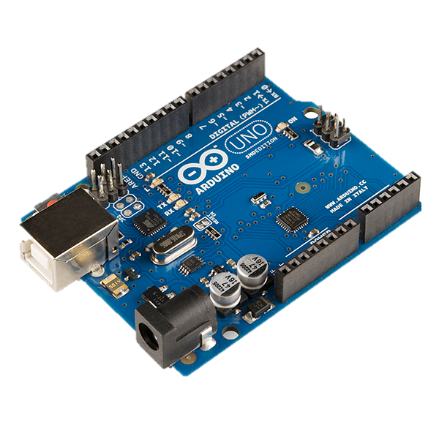
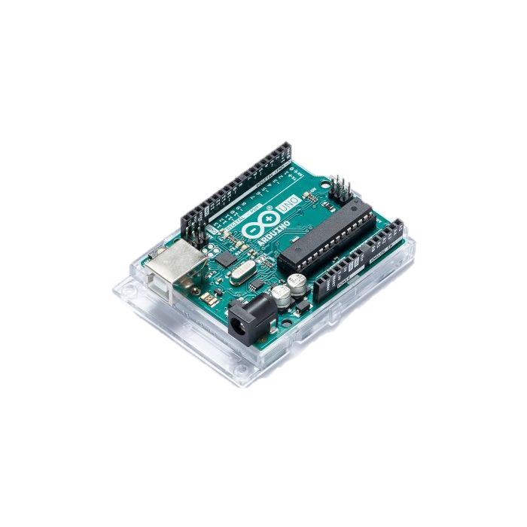
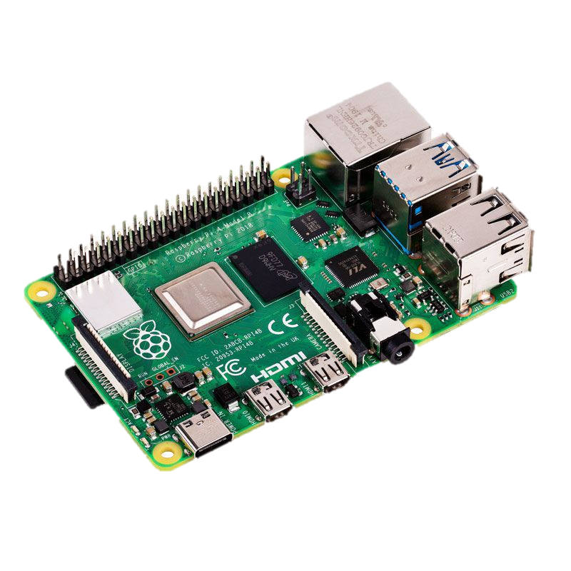
Microcontroller
Microcontrollers are a tiny, self-contained computers hosted on a microchip. They enable connectivity and control in all the things which could be connected to the internet.
Much like CPU in Computers.
Easy to Program in C or python language.

Slide 12
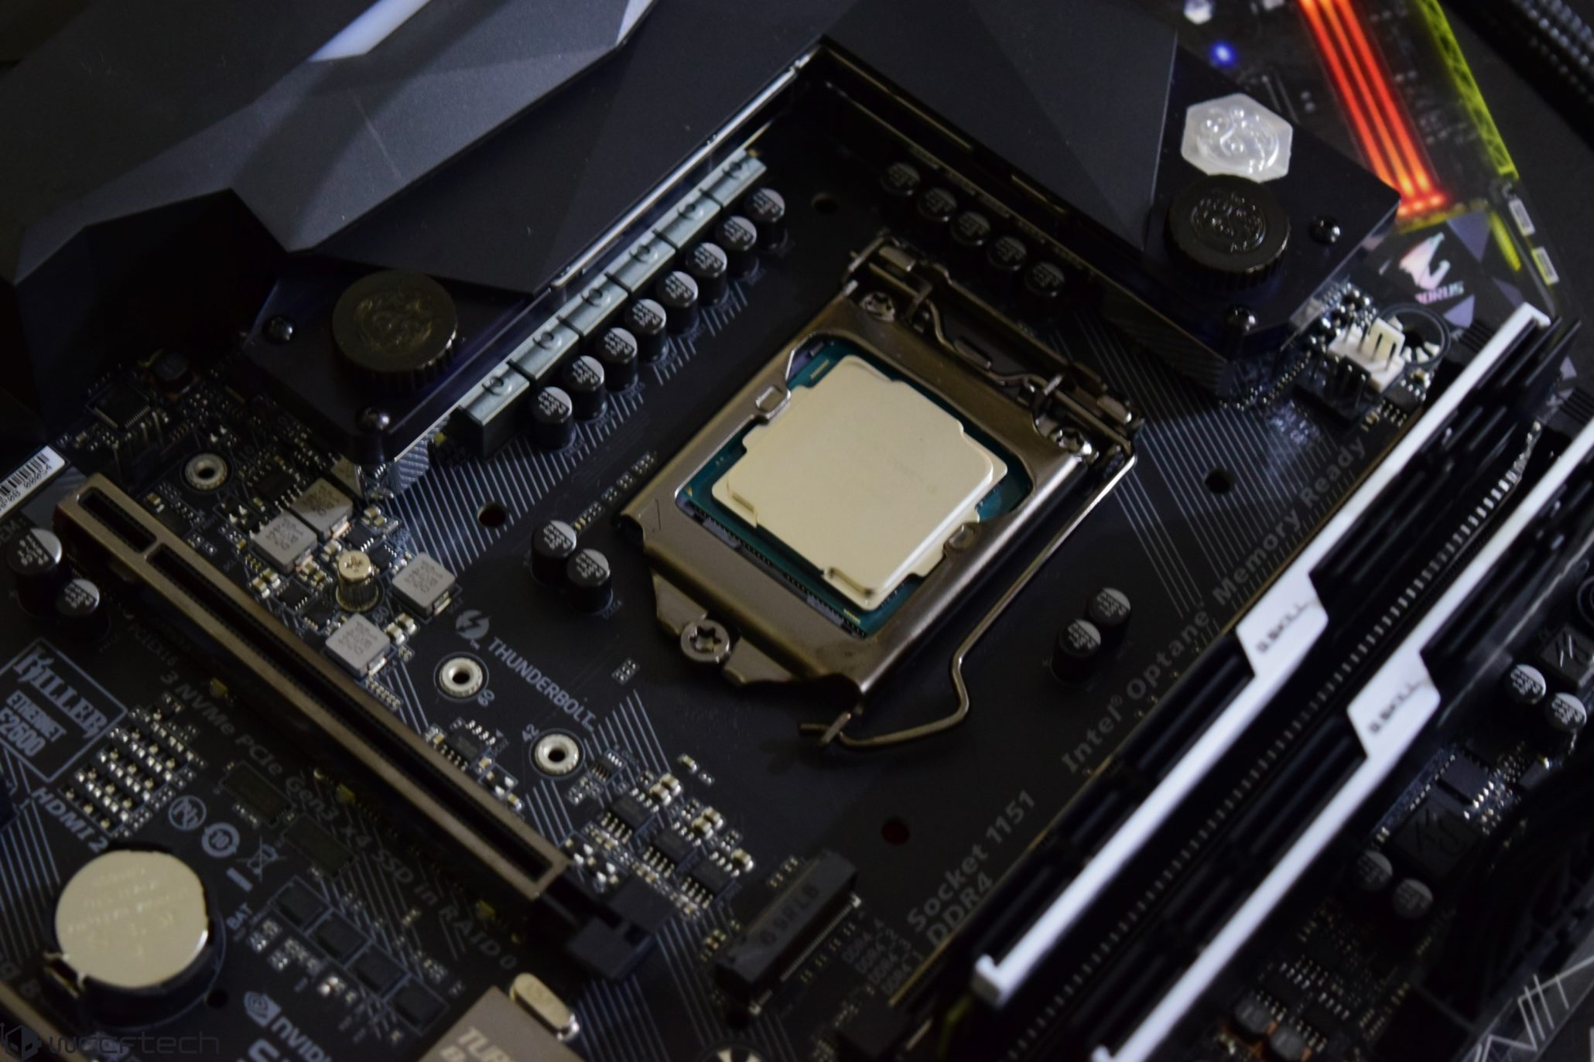
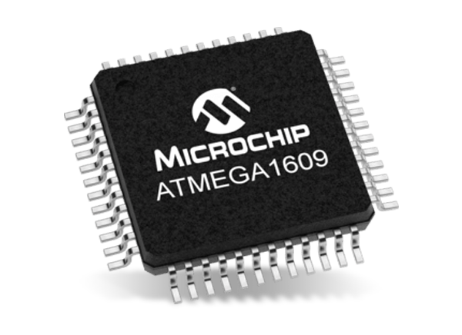
Key Difference
Microprocessor Consists of only a Central Processing Unit, whereas microcontroller Contains a CPU, Memory, I/O all integrated into one chip.

Slide 13
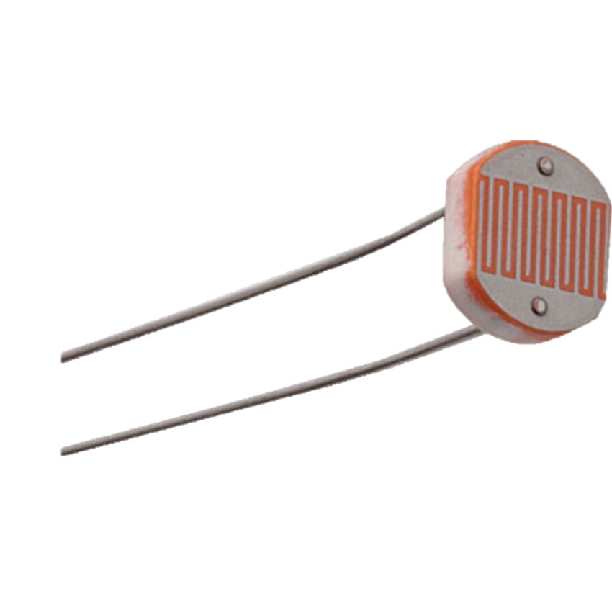
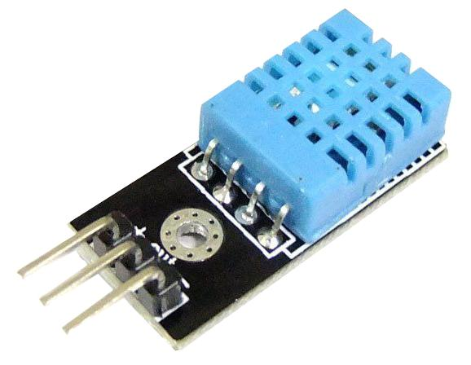
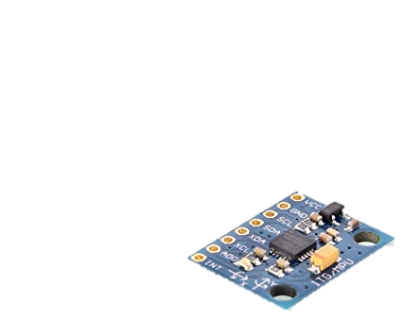
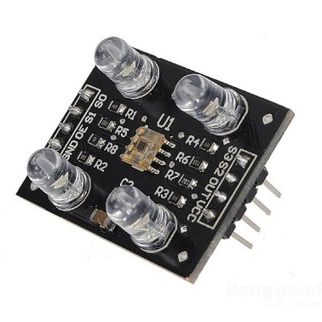
Sensors
Light Dependent Resistor
Sensors are tiny little devices used to collect information from our environment.
Like, Moisture, temperature, Humidity, Light Intensity, Color, etc.
You can say, it provides and interface to connect to our environment.
DHT-11 Temperature + humidity
TCS 3200 color Sensor
MPU 6050
Accelerometer + Gyroscope

Slide 14
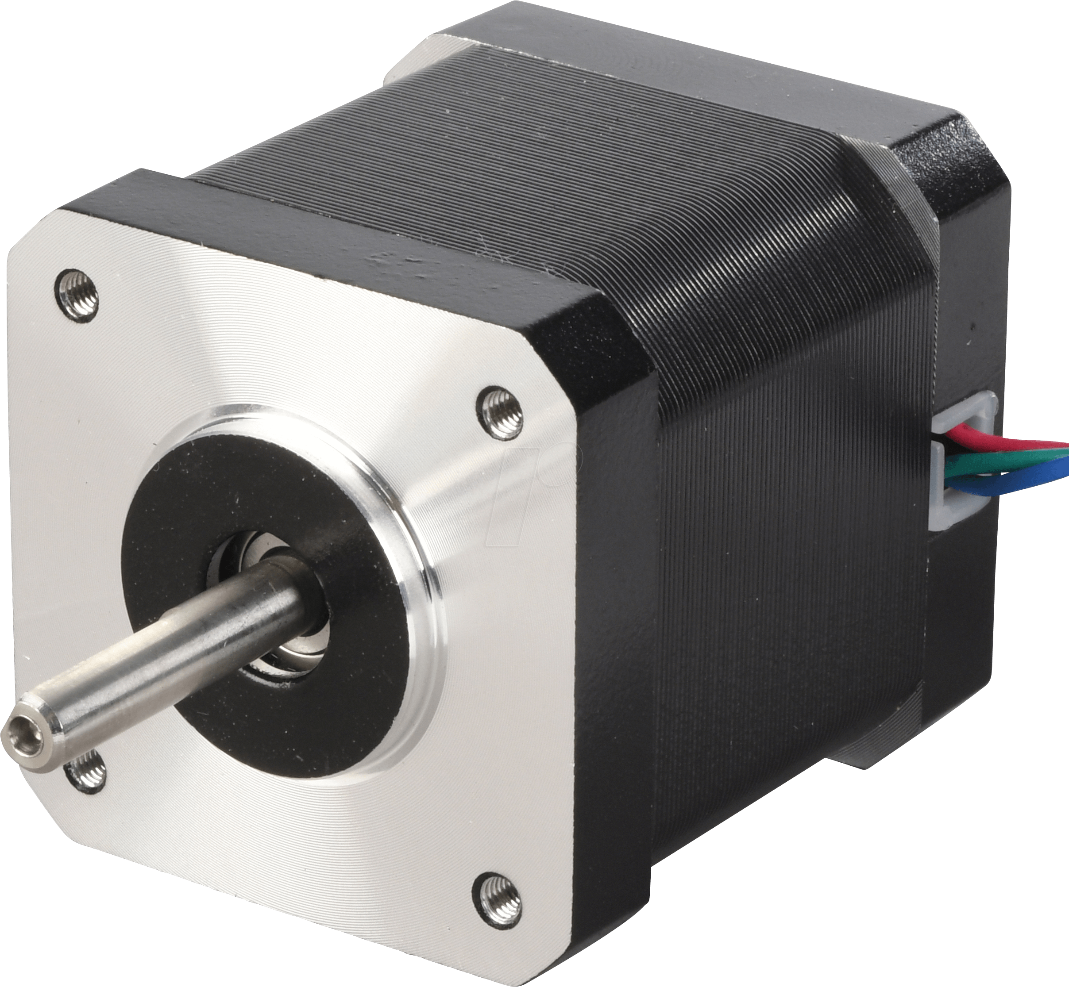
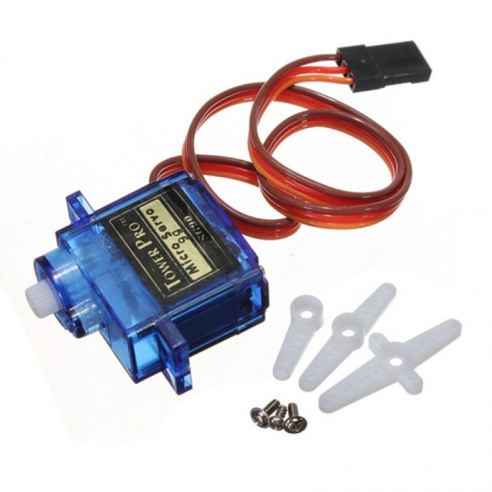
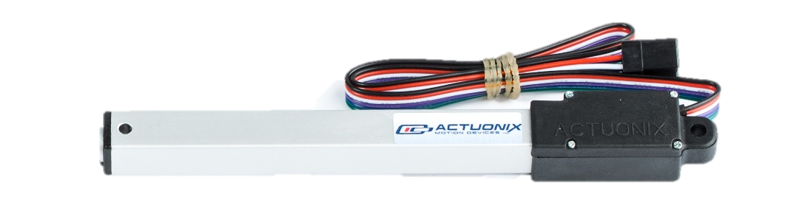
Actuators / Motors
These are electrically controlled mechanical components which provides mobility or movement to our applications.
We can control speed, rotation direction, angle and torque of motors.
Actuators provides linear motion like hydraulics, and motors provides circular motion.
Stepper Motor
Linear Actuator
Servo Motor

Slide 15
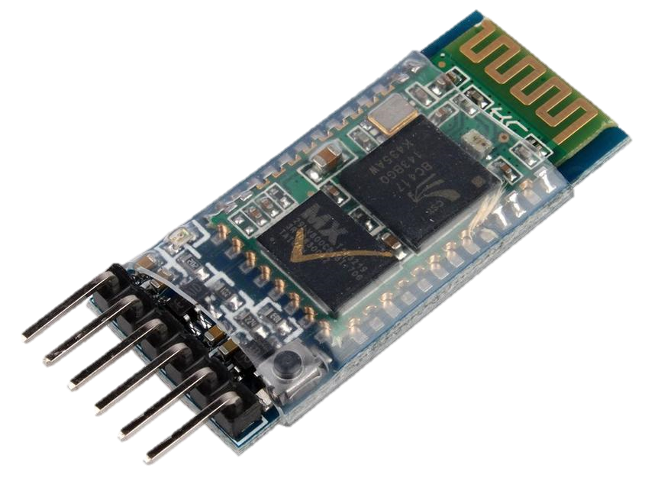
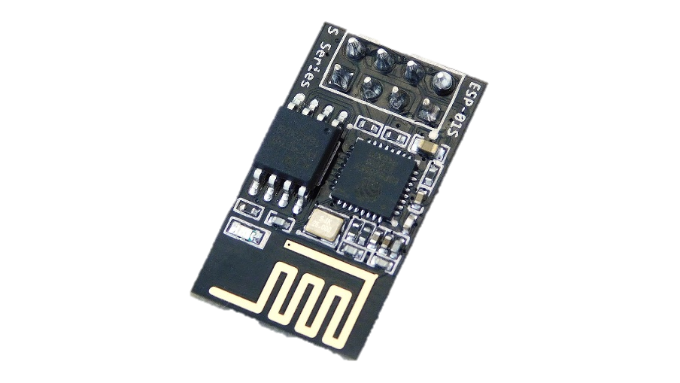
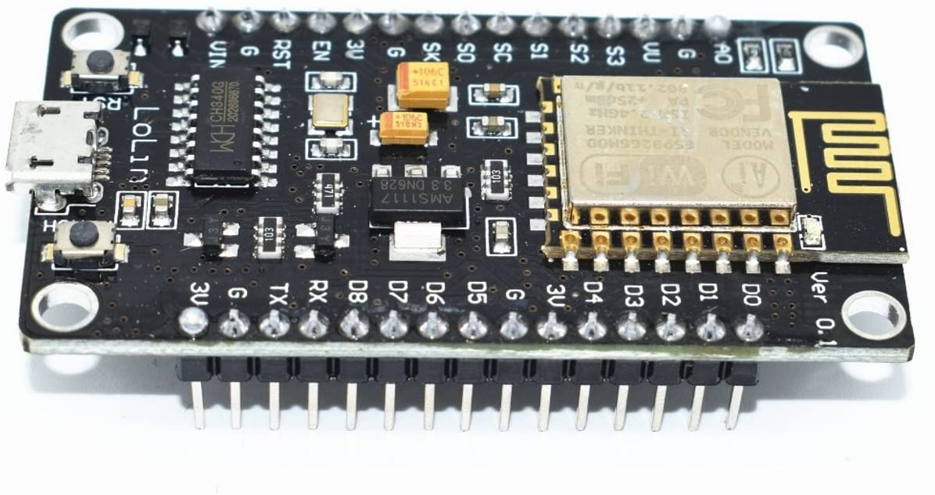
Connectivity
To connect our devices to the internet or some sort of network we will need controllers for connectivity, like Bluetooth or Wi-Fi
To create connected Projects I would recommend go ahead and take a look at Blynk app.
Bluetooth
Esp8266
NodeMCU

Slide 16
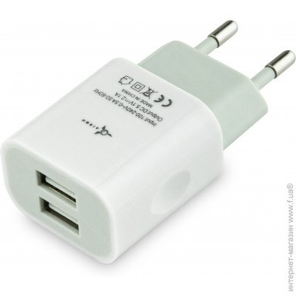
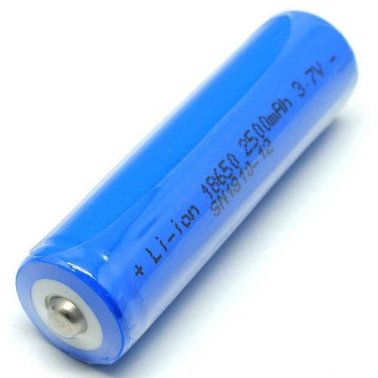
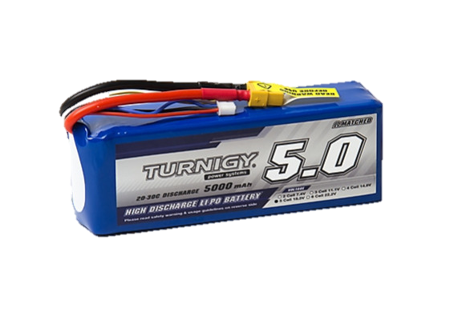
Power
All electronic or electrical devices needs power. For electrical appliances power from wall is used.
Electronic appliances uses DC to power things up so an SMPS or some kind of rectifier will do the job, even a phone charger can also be used.
To making things portable various types of batteries are available.
Li-ion
Lithium Polymer Battery

Slide 17



Cloud Computing and Programming
Programming languages like python is popularly used in IoT applications.
Python programming is used for Machine Learning and Artificial Intelligence also, which gives advantage to IoT developers to develop more Autonomous systems.
C programming is commonly used in Arduino, it’s a very power programming language which provides better control on your Arduino projects.
To connect IoT device to internet and provide services, Cloud platform is required.
Cloud platforms like Google GCP, Amazon AWS, and Microsoft Azure are openly supporting IoT development.
Its most affordable or sometimes free of cost way to start your project right now.

Slide 18
What is Arduino?
Arduino is a open-source prototype platform based on an easy-to-use hardware and software.
It consists of a microcontroller attached on a development board, which can be programmed easily with the help of Arduino IDE (Integrated Development Environment).
Arduino IDE is used to write and upload the program to the physical Board.

Slide 19
Installing Arduino IDE

Slide 20
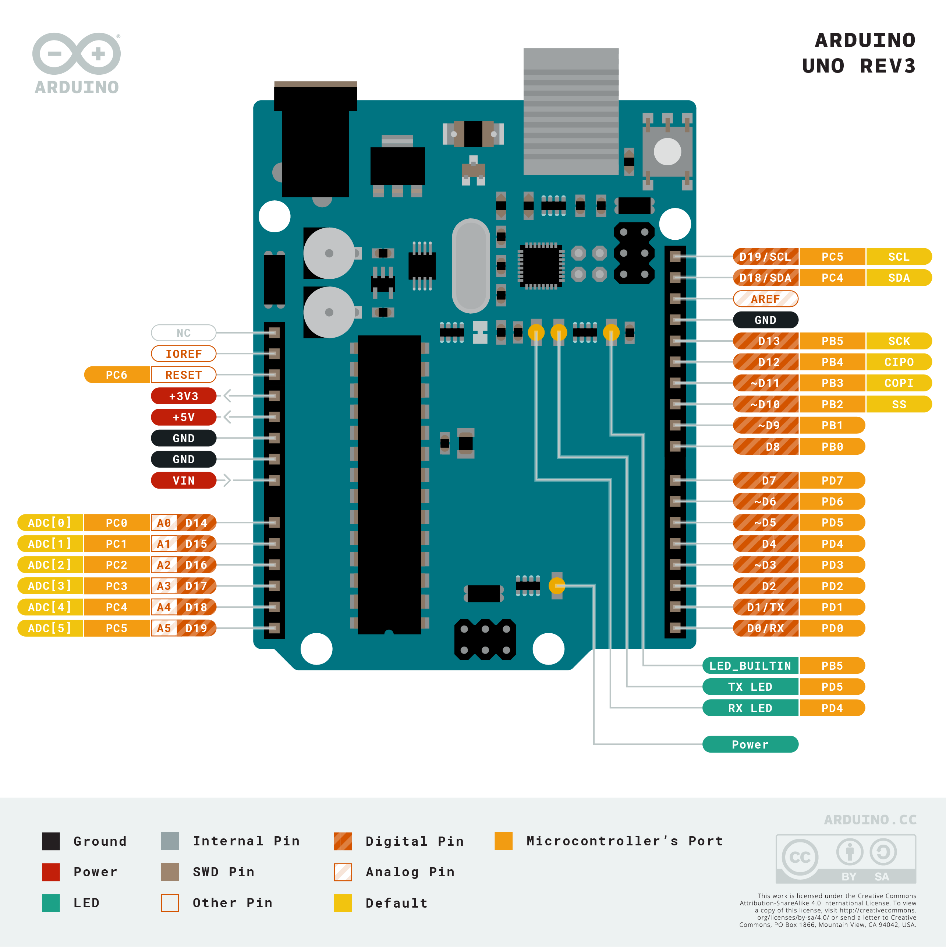

Slide 21
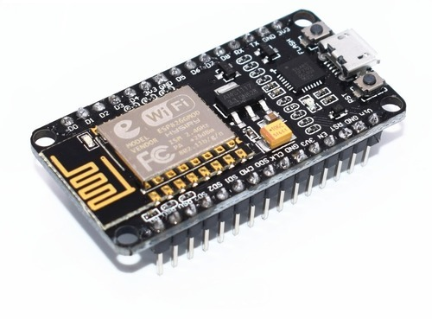
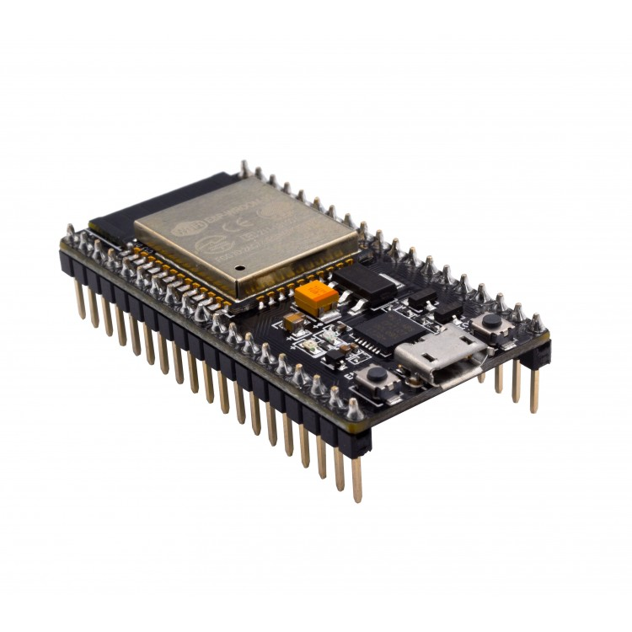
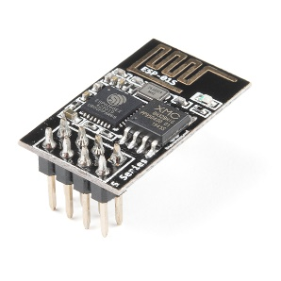
NodeMCU IoT development Board

Slide 22
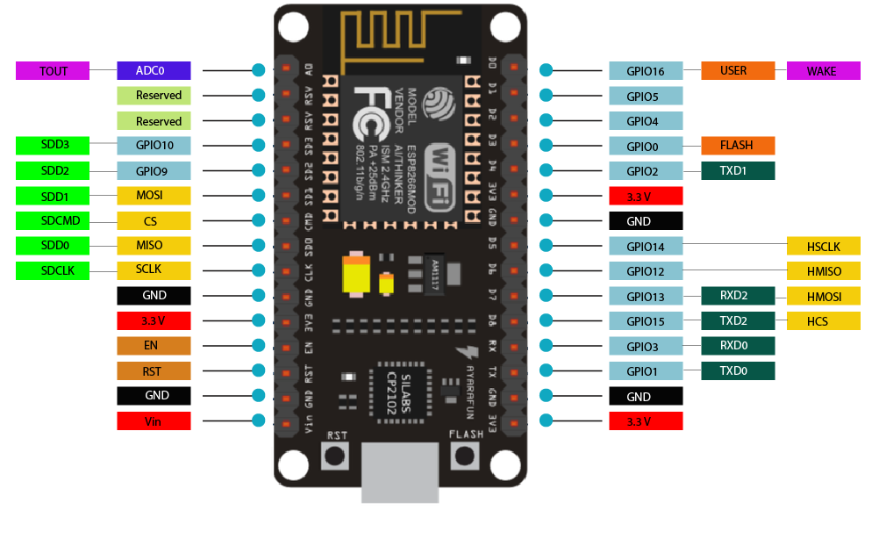
NodeMCU Pinout

Slide 23
Let’s Code

